Slide 1
BERTopic
DATASCI 224
Brian Nishimine

Slide 2
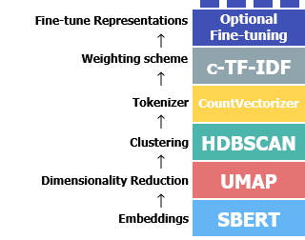
BERTopic
Topic Modelling
Latent Dirichlet Allocation (LDA)
Non-Negative Matrix Factorization (NMF)
Length of documents
Pre-trained models allows for shorter documents
https://maartengr.github.io/BERTopic/algorithm/algorithm.html#visual-overview
Notes:
BERTopic is a topic modeling framework which is the extraction of topics from a collection of documents. The biggest difference between BERTopic and other topic modelling models, such as LDA and NMF, is that BERTopic utilizes pretrained sentence transformers rather than the classic bag of words approach. This basically means that instead of relying upon the statistical makeup of words in documents, semantic meaning is captured.
An additional reason to use BERTopic is that due to it using sentence transformers, it is able to handle short documents. This was particularly important for what I wanted to work on, as each of my documents only consists of 10-20 words.
There are five main parts to BERTopic, embeddings, dimensionality reduction, clustering, tokenizing, and weighting, with optional fine tuning afterwards.

Slide 3
Embedding
SBERT
all-MiniLM-L6-v2
Notes:
A common form of sentence embedding for BERTopic is using Sentence-BERT. This embedder embeds entire sentences rather than individual words, which is useful for the purpose of topic modelling.
all-MiniLM-L6-v2 is a commonly used encoder that has been trained for semantic similarity tasks. This one is an english language model. It breaks down each document into 384 dimensions, which will be reduced in the next step.

Slide 4
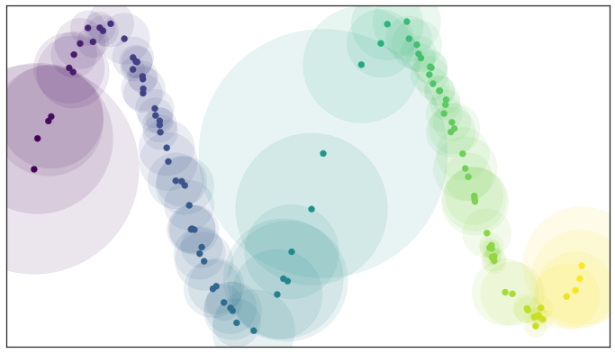
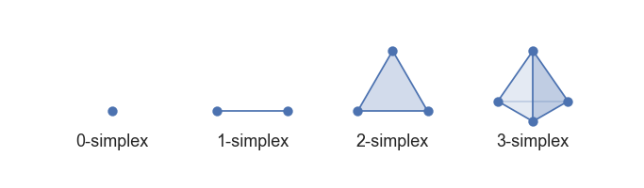

Dimensionality Reduction
Unifold Manifold Approximation and Projection (UMAP)
Nonlinear
Equation
E -> Set of all possible 1 simplexes
e -> Weight of 1 simplex
w_{h}(e) -> Weight in higher dimension
w_{l}(e) -> Weight in lower dimension
https://umap-learn.readthedocs.io/en/latest/how_umap_works.html
Notes:
The method that BERTopic prefers for dimensionality reduction is Unifold Manifold Approximation and Projection. One reason that this is preferred is because it is non-linear dimension reduction, which attempts to preserve non linear structures within data. This means that points that exist as neighbors in higher dimensionality space should theoretically stay as neighbors even when dimension reduced, which can be lost when using linear dimension reduction.
UMAP starts out by constructing a high dimensional graph. It calculates a local radius for each point based on the distance to the nth nearest neighbor. N in this case is a chosen parameter. In order to transform this to a lower dimensionality, we use simplices, which are just ways to build a k dimensional object. A zero simplex is a point, a one simplex is a line, a two simplex is a triangle, a three simplex is a tetrahedron, and so on. For the purpose of UMAP only zero and one simplices are used. Overlapping radii are given a one simplex, and non overlapping radii are given a zero simplex. When comparing the high and low dimensional spaces, all zero simplices, or points, are shared between them. If we look at a set of all possible one simplices, we can treat these as bernoulli variables, in that the one simplice either exists or it doesn’t, allowing us to use cross entropy.
This equation represents the cross entropy equation, where the front half attempts to pull together points that were neighbors in the higher dimension, and the second half of the equation tries to push apart those that were not.

Slide 5
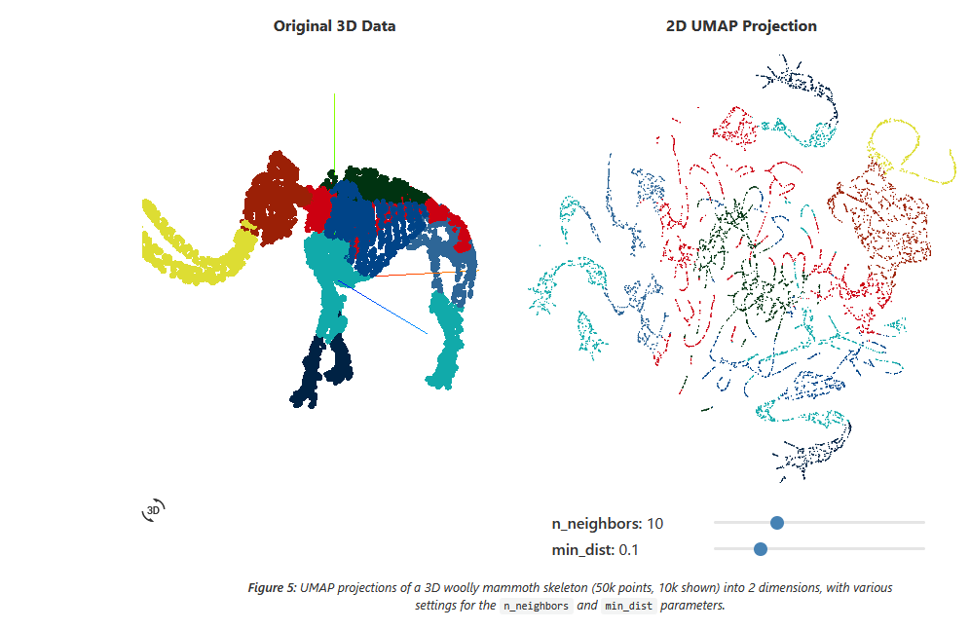
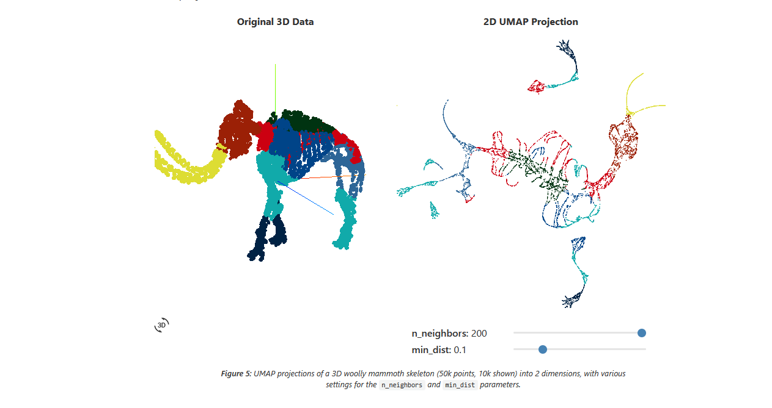
https://pair-code.github.io/understanding-umap/
Notes:
This was an example from one of the sites that I used to try and understand UMAP.

Slide 6
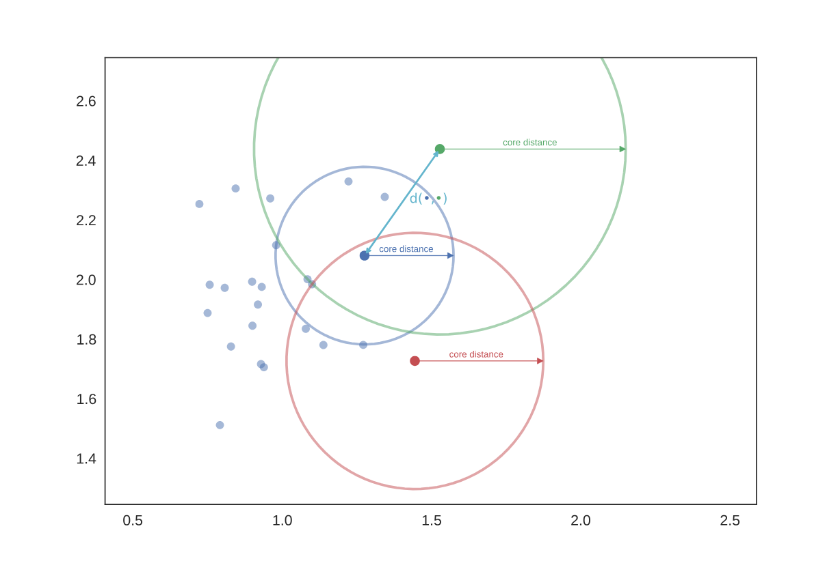
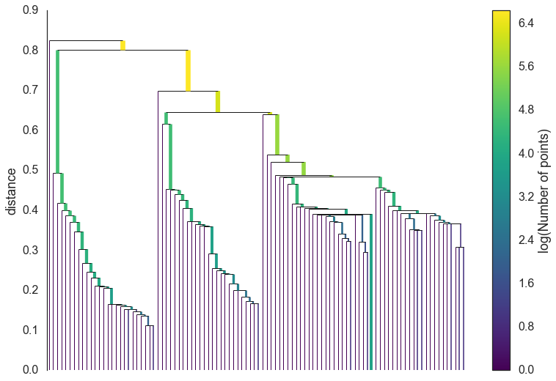
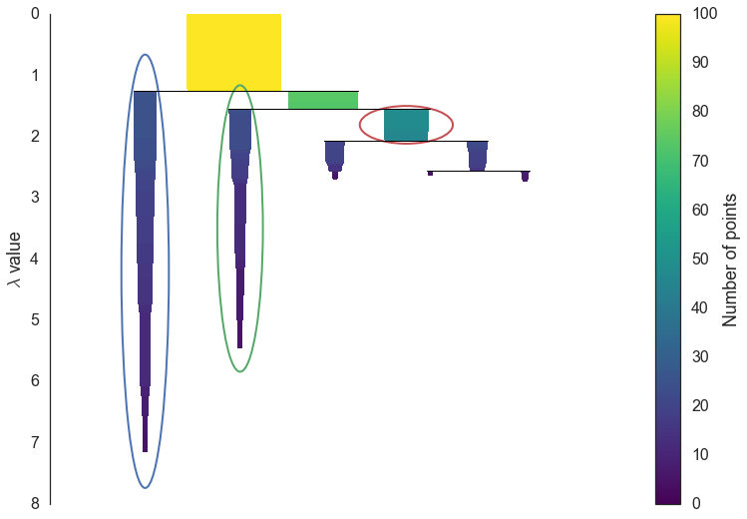
Clustering
Hierarchically Density-Based Spatial Clustering Applications with Noise (HDBSCAN)
Density Estimate
KNN
Mutual Reachability Distance
Minimum Spanning Tree
Build the Cluster Hierarchy
Condense the Cluster Tree
Extracting Clusters
https://hdbscan.readthedocs.io/en/latest/how_hdbscan_works.html
Notes:
The default clustering method is Hierarchically Density Based Spatial Clustering Applications with Noise, or HDBSCAN. This starts by using KNN, and assigning a core distance between the point and its kth neighbor.
We then convert the distances into mutual reachability distance. This example here is displaying the core distances for each of the circles. In this example, we see that the distance between cores for the red and the green circle span the radii. This means that the mutual reachability distance is just that distance. For the green and blue circles, we can see that the distance between cores doesn’t reach the radii for the green circle.This means that we extend our mutual reachability distance to the radii of the green circle through the blue core.
To build the tree, we set a threshold. We assign weights to each of the mutual reachability distance lines, and drop weights that are above that threshold. This eventually creates our tree. We can do this efficiently by building it one edge at a time, adding the lowest weight that connects the tree to a new point.
To build the cluster hierarchy, we sort all weights into ascending order, and then begin removing them into separate clusters, starting with the largest. Eventually, every point will be isolated.
Immediately after we split all the clusters, we recondense them back into larger clusters. We can set a minimum cluster size to ensure that we don’t have hundreds of clusters consisting of individual points. We walk through each node split and determine if either node created falls under the minimum cluster size.
In order to extract clusters, we use a simple formula, 1 over the distance to determine a value lambda. This lambda value is assigned for multiple instances, lambda birth and lambda death for when a cluster forms and then when it splits, and lambda p for each point within a cluster. We do some summation between the points and births to determine the overall stability of the cluster, which basically is just to say that we are selecting the clusters with the largest area .

Slide 7
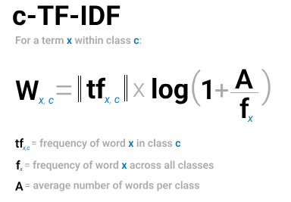
Topic Representation
Tokenization: Bag of words
Class-Based Term Frequency - Inverse Document Frequency (c-TF-IDF)
https://maartengr.github.io/BERTopic/algorithm/algorithm.html#5-topic-representation
Notes:
Now that we have our clusters, we want to interpret them. In order to extract meaning from our embeddings, we actually need to go back to bag of words which we opted to not use in the beginning. In order to do this, we combine all documents within a cluster into a single document. We then run bag of words on each cluster individually. This gives us topic level word representations.
Now that we’ve done that, we can run our class-based term frequency inverse document frequency model on the words. Rather than giving us the importance of words between documents, it now gives us the importance of words between clusters. The plus one within the logarithm keeps all of our values positive in this case. This half gives us our class based inverse document frequency representation, which we then multiply by our term frequency in order to get the score for each word in each class. This should give us a set of words that describe each topic.

